Slide 1
Eurozone crisis and its impact on Moldova
Presentation at the European Business Association (EBA)
Chisinau, 24 April 2013
Dr. Ricardo Giucci
German Economic Team Moldova

Slide 2
The eurozone crisis = An ugly combination of public debt, banking and growth crisis
Banking crisis
Sovereigns come to the rescue of banks, thereby endangering their own credit worthiness
The weak banking sector withdraws loans from companies
Banks suffer from exposure towards sovereigns
Low growth or recession hits the banks‘ balance sheets
Sovereigns cut their expenditures because of low growth
Public debt crisis
Growth crisis
Low growth means lower revenues, which aggravates the problem of debt consolidation
Source: IMF, BE
2
Notes:
Auch das bringt Übersicht in eine scheinbar so unübersichtliche Krise. Kompliziert wird die aktuelle Krise dadurch, dass wir es mit vielen Krisen gleichzeitig zu tun haben, die sich gegenseitig verstärken. Dazu kommt noch, dass Maßnahmen, die gegen die eine Krise ergriffen werden (wie zum Beispiel Rekapitalisierung des Bankensektors) gleichzeitig die Schuldenkrise der Staaten verschärft. Anderes Beispiel: Maßnahmen, die die Staatsschuldenkrise entschärfen sollen (also Sparmaßnahmen) verschärfen die politische Krise und die Wachstumskrise

Slide 3
Contents
A. Causes for the eurozone crisis
B. Measures implemented to combat the eurozone crisis
C. The case of Cyprus
D. Impact on Moldova
3

Slide 4
Causes for the eurozone crisis
High public debt
High private debt
Loss of competitiveness
4

Slide 5
1. High public debt: Lax fiscal policy
10 year gov bond yields
As interest rates went down significantly prior to the start of the eurozone, some governments took advantage of the lower interest rate burden to increase spending and public debt
Actually, no risk was assigned to bonds from Greece, Portugal and Italy in the period of 2001 to 2007, even though the fiscal problems were well known
Thus, bond markets failed to act as vigilantes in 2001 to 2007
Since 2008/2009 investors differentiate once again, as they did in the 90ies
Source: Eurostat
5
Notes:
Die Bond Märkte haben in der Zeit zwischen 2001 und 2008/09 überhaupt nicht als vigilants funktioniert. Man kann dies darauf zurückführen, dass kein Politiker ernsthaftes Interesse hatte, die Investoren daran zu erinnern, dass es eine Non-Bailout Klausel gibt, da auch keiner ein kurzfristiges Interesse an höheren Zinsen hatte.
Investoren haben geglaubt, dass das Risiko, griechische Staatsanleihen anstatt von deutschen zu halten, mit 20 basispunkten abgegolten ist, und das fast 8 Jahre lang.
Ratingagenturen hatten durchaus zwischen den Ländern differenziert, wenngleich ein Einfach A für Griechenland aus heutiger Sicht sicherlich auch nicht gerechtfertigt war

Slide 6
2. High private debt: Sharp increase
Private debt rose sharply, especially in Ireland, Cyprus and Portugal
However, regulators and markets were not worried about events
Banks and markets: No risk differentiation and thus very low interest rates
Relationship public-private debt
Greece and Ireland are two extreme cases:
While Ireland had a very high private debt ratio, it‘s public debt was one of the lowest
In Greece the reverse issue is true: The private debt ratio rather low, while the public debt ratio is the highest in the list here
Private debt as % of GDP (as of end 2010)
Source: Eurostat
6

Slide 7
3. Loss of competitiveness due to increase of unit labour costs
Unit labor cost index (2000 = 100)
In Ireland unit labour costs increased most, but came down significantly after the eruption of the crisis
In Greece, labour cost evolved with similar dynamism as in Ireland, without having been accompanied by a corresponding positive development of the economy
Spain and Italy are faced with similar problems
In Germany unit labour costs went down, partly due to the “Agenda 2010”
Before EMU: Loss in competitiveness in Southern countries regained through devaluation
Since EMU: Exchange rate as an instrument of national policy does not exist anymore; thus, devaluation not possible anymore
Source: ECB, Eurostat
7

Slide 8
B. Measures implemented to combat the eurozone crisis
Adjustment programs using new instruments
The role of the European Central Bank
Decision on a common banking supervision
8

Slide 9
1. New instruments & institutions had to be created
Original architecture of European Monetary Union (EMU)
No eurozone instruments foreseen to support distressed countries
And: No IMF-type institution within the EU or the EMU to rescue countries
As Greece got in trouble:
Bilateral loans from Euro members
Setting up of a troika, consisting of EU Commission, ECB and IMF
Then: Swift creation of new instruments/institutions
EFSM: European Financial Stabilisation Mechanism; lending capacity: EUR 60 bn
EFSF: European Financial Stability Facility; lending capacity: EUR 440 bn
ESM: European Stability Mechanism; lending capacity: EUR 500 bn
9

Slide 10
Adjustment programs in some member countries: Austerity & reforms
Overview of adjustment programs in member states
 | Greece | Ireland | Portugal
Period covered by EU assistance | Assistance available up to December 2014 | Assistance available up to December 2013 | Assistance available up to July 2014
Financial instruments | EFSF; Bilateral loans from eurozone member states | EFSF; EFSM; bilateral loans from the UK, Sweden and Denmark, Irish reserves | ESFS; EFSM
Amount granted by the EU | Up to € 197.6 bn | Up to € 45 bn | Up to € 52 bn
Total size of the assistance (including other lenders) | € 245.7 bn (48.1 bn from IMF) | € 85 bn (22.5 bn from IMF) | € 79.5 bn (27.5 bn from IMF)
Main areas of policy conditionality | * Fiscal consolidation * Fiscal governance and reporting reform * Other structural reforms | * Fiscal consolidation * Labour market reform * Other structural reforms | * Fiscal consolidation * Banking sector recapitalisation and deleveraging * Other structural reforms
Source: European Commission, IMF
10

Slide 11
2. Monetary Policy: The role of the ECB
2011: Purchases of gov bonds on the secondary market (more than EUR 200 bn)
2012: Intensive use of long-term refinancing operations (LTROs), partly used by banks to buy gov bonds
6th Sep 2012: ECB announces restart in buying short-term gov bonds “Outright Monetary Transactions (OMT)” without ex-ante limits
Conditions: Adjustment program in place, EFSF/ESM also engaged in purchases of bonds
Own view:
Purchase of gov bonds certainly not ideal
But: Fiscal tools at the level of the eurozone still not working properly
Thus: Purchases of gov bonds as an emergency measure until proper fiscal tools are in place
Monthly purchases of government debt
Source: IMF, Bloomberg
11

Slide 12
3. Decision on common banking supervision
December 2012: Agreement by eurozone finance ministers on common banking supervision
Institution: ECB will become the bank supervisor of the eurozone
However: Only “big” banks (ca. 150 out of 6,000) will be directed supervised by ECB
Assets of EUR 30 bn or more OR
Assets of 20% of national GPD or more
But: Minimum of 3 banks per country
If deemed necessary, ECB can also supervise smaller banks (own decision by ECB)
Strict separation from monetary policy, to avoid conflicts
Expected start of direct supervision: March 2014
Own view
Important step to allow direct financial support by ESM to commercial banks; de-linking of public debt and banking crisis
Necessary step to make the eurozone a more “complete” monetary union
Open questions: Common bank resolution institution and deposit guarantee scheme to follow suit? First step towards a banking union?
Source: European Commission, BNP
12

Slide 13
C. The case of Cyprus
Background
Significant impact of Greek crisis, especially the haircut on public bonds, in which Cypriot banks invested heavily, as well as loan-exposure to crisis-hit Greece
Massive recapitalization needs for domestic banks, which were in effect insolvent
At the same time, banking sector oversized (7 times bigger than GDP, compared to EU-average of 3.5); significant share of non-resident deposits (e.g. from CIS countries)
Cyprus serves as an offshore financial transactions hub for the CIS region for a number of reasons (e.g. favorable double taxation treaties)
Financial services and tourism (which are related) are the main economic sectors
While public debt of the sovereign was not huge (86.5% in 2012), the additional recap demands (ca. 60% of GDP) clearly overstretched its financial capabilities
Thus, request for support program (“bail-out”) from EU partners

Slide 14
Cyprus – Recent Developments
Support-package:
Negotiations with Euro Group led to a EUR 10 bn bail-out loan (9 bn ESM and 1 bn IMF)
Majority of Cyprus’ own program contribution of EUR 7 to 13 bn comes through “bail-in”:
Laiki Bank split into good/bad bank, the latter will be liquidated; (massive) losses imposed on unsecured depositors (“bail-in”)
Bank of Cyprus to be restructured; losses on unsecured depositors
Other measures (e.g. privatization, taxation) leading to a shrinking of the financial sector
Introduction of temporary capital controls to preserve financial stability
Our view:
New stage of the anti-crisis measures, as “bail-in” complements “bail-out” in burden-sharing
Not clear if this approach will be a model for the future (e.g. risk of contagion)
Cyprus needs to find a new business model; this will be a major and painful challenge

Slide 15
D. Impact on Moldova
Overview of transmission channels
Public debt channel
Banking channel
Economic growth channel

Slide 16
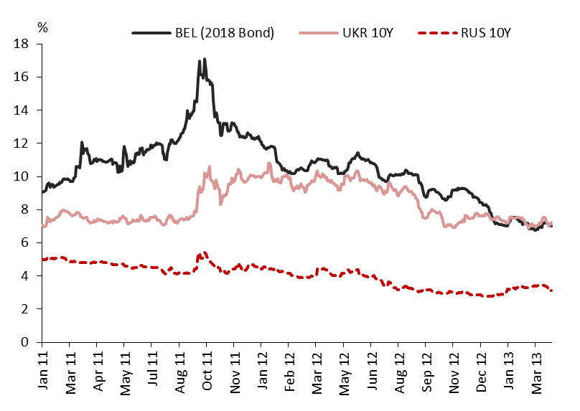
1. Public Debt Channel
The public debt crisis in the eurozone had a negative impact on low-rated sovereigns outside the eurozone
Ukraine and Belarus (same rating category as Moldova/B3) recorded high and volatile interest rates on public bonds issued on foreign markets (Eurobonds)
Furthermore, Ukraine was not able to access the Eurobond market between Q3:2011 and Q2:2012
In comparison: Russia’s (Baa1/Investment Grade) yield much less affected
Since Moldova has not issued bonds in foreign markets, no direct impact
Eurobond yields in Ukraine, Belarus, and Russia
Source: Cbonds

Slide 17
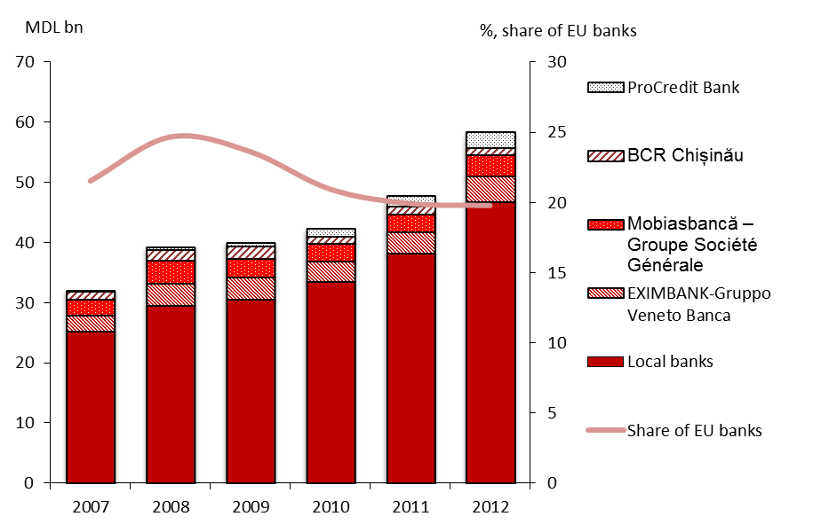
2. Banking channel
Four banks from the EU are active in Moldova
In absolute terms, assets and lending by EU banks in Moldova increased in recent years
However: The contrary is the case in relative terms; market share of EU banks dropped from ca. 25% to 20%
Mixed impact on Moldova
Total banking assets and share of EU banks
Source: Calculations based on NBM data and banks’ balance sheets

Slide 18
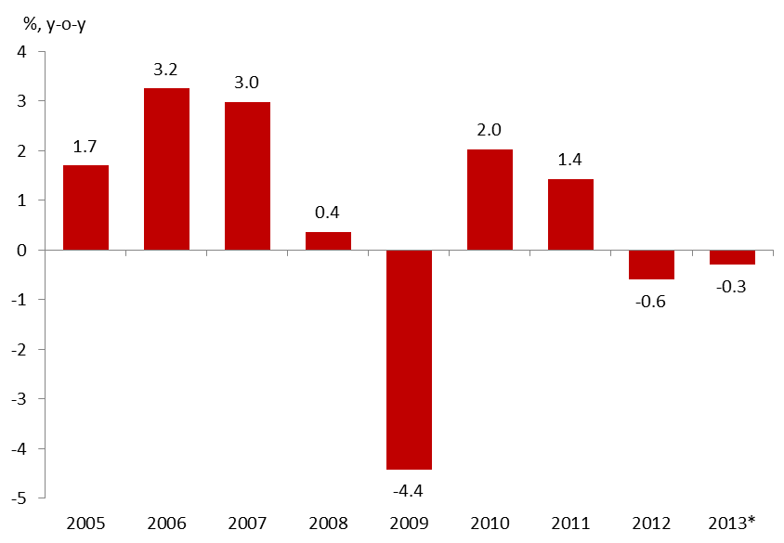
3. Economic Growth Channel
Part of the eurozone faces an economic growth crisis
In 2012, economic growth was negative in the eurozone
This situation is likely to last in 2013, as:
Necessary fiscal austerity limits the space for fiscal policy
Monetary policy, which is already expansionary, is faced with structural headwinds
Weak banking sector limits new lending
GDP growth in the eurozone, %
Source: Eurostat, *Eurostat forecast

Slide 19
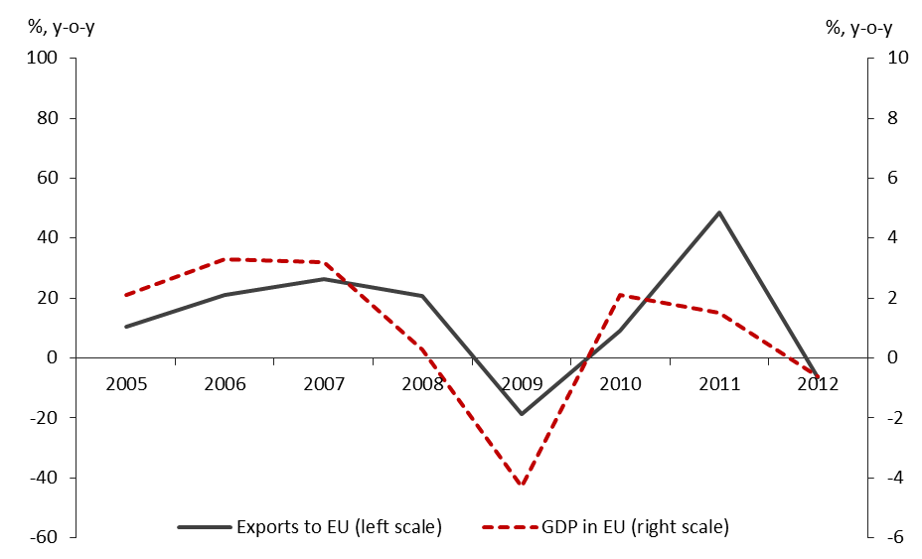
Close relationship between EU economic growth & Moldova’s exports
How did Moldova’s exports to the EU react in practice?
Close and stable relationship between EU growth and Moldovan exports to the EU
The recession in EU in 2012 contributed to a fall of 6.4% in Moldova’s exports to EU
Growth of Moldovan exports to EU and GDP growth in EU-27
Source: NBS and Eurostat

Slide 20
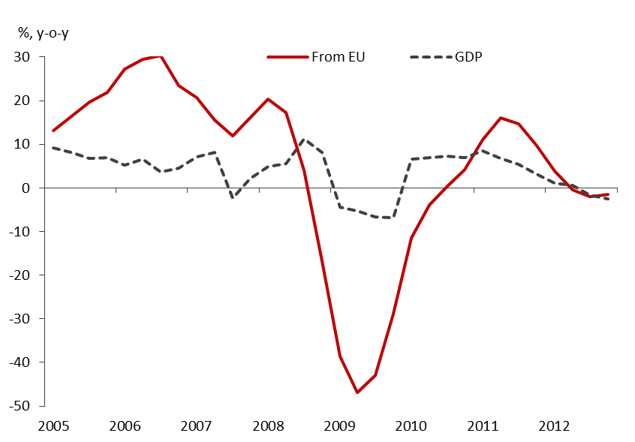
Remittances play a major role for the economic growth
Apart from trade flows, remittances from the EU play a significant role for Moldova
Total remittances (according to World Bank definition) account for about one quarter of Moldova’s GDP (2012)
Remittances from the EU declined during the crisis
Empirical analysis shows that these inflows are highly correlated with the domestic business cycle
Decline in remittances caused a drop in economic growth
Significant negative impact on Moldova
Growth of Moldova’s GDP and remittances from EU
Source: Authors’ calculations based on NBS and NBM data
Note: Time series for remittances were filtered (HP, lambda = 1)

Slide 21
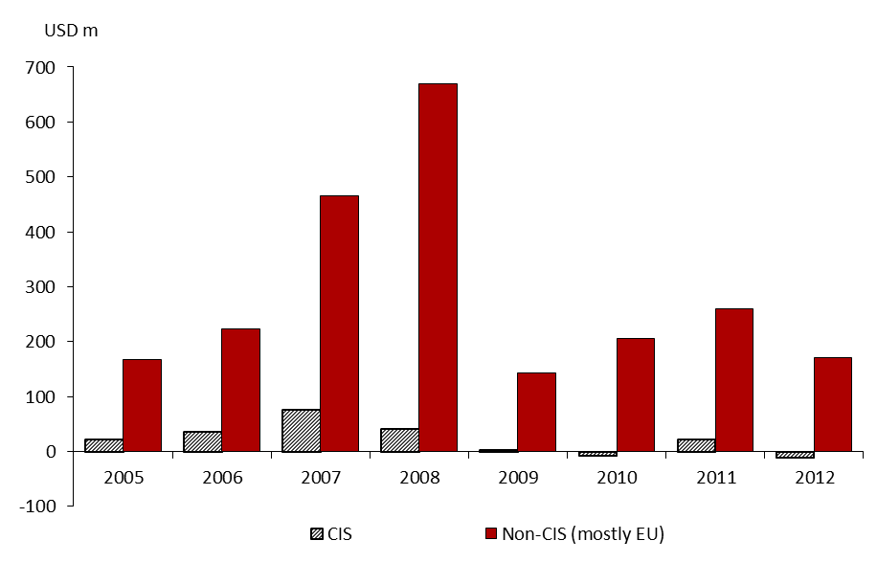
FDI inflows from EU declined recently
FDI inflows from CIS and non-CIS countries
2009: Rapid decline of FDI inflows in the context of the global financial crisis
2010/2011: Increase in FDI inflows from EU
2012: Significant decrease in FDI inflows from EU
Negative impact on Moldova‘s economy through a decline in FDI from the EU
Source: NBM
Note: There are no available data about FDI coming from EU. However, a report from the Ministry of Economy revealed that their share in total FDIs hovers at around 74%-75% and did not change during the crisis

Slide 22
Summary impact on Moldova
1. Public debt channel
No direct impact, since there is no foreign marketable debt outstanding
2. Banking channel
Mixed impact, as market share of EU banks active in Moldova went down
3. Economic growth channel
Negative impact via declining exports to the EU
Negative impact through a drop in remittances from the EU
Also FDI from the EU declined significantly during the eurozone crisis
To sum up:
Strong impact of the eurozone crisis on Moldova’s economy
Policy makers need to pay close attention to current events

Slide 23
Contact
Dr. Ricardo Giucci
giucci@berlin-economics.com
BE Berlin Economics GmbH
Schillerstr. 59, D-10627 Berlin
Tel: +49 30 / 20 61 34 64 0
Fax: +49 30 / 20 61 34 64 9
23

Slide 24
Back-up slides

Slide 25
On the eurozone level: Lax implementation of fiscal rules
Budget deficit and public debt 1999 and 2011,
in % of GDP
To compensate for the flaws of the construction of the eurozone (amongst other things no political or fiscal union, limited labour mobility, no banking union), the founders of the eurozone defined the Maastricht criteria:
Budget deficit limit of 3% of GDP
Public debt limit of 60% of GDP
However, only a few countries fulfilled these criteria at the start
Most prominent countries not to fulfil these criteria: Italy and Greece
Thus, fiscal rules existed and they were not bad, but they were not applied or implemented
Source: ECB
25
Notes:
Um die Glaubwürdigkeit nicht vollkommen aufzugeben, hat man sich letztlich nur noch auf das 3% Kriterium konzentriert und das 60% Kriterium nur als zu erreichendes Kriterium berücksichtigt. Griechenland hat dann selbst die Zahlen für dieses Kriterium gefälscht.

Slide 26
Overview of new instruments: EFSM, EFSF and ESM
 | EIB | EFSM | EFSF | ESM
Full name | European Investment Bank (in place before crisis) | European Financial Stabilisation Mechanism | European Financial Stability Facility | European Stability Mechanism
Legal Foundation | International Financial Institution | Supranational administrative body | Private company | International Financial Institution – multilateral lending institution
Mandate | EU‘s long term lending institution | Provide financial assistance to countries in difficulty | Provide financial assistance to countires in difficulty | Provide financial assistance to countires in difficulty
Shareholders | 27 EU member states | 27 EU member states | 17 euro-zone member states | 17 euro-zone member states
Contribution key | According to their economic weight | According to their economic weight | According to their share in the ECB‘s capital | According to their share in the ECB‘s capital
Support to bondholders | Explicit and irrevocable obligation for EIB‘s sharehlders to pay their own share of the callable capital | EU‘s budget and ultimately explicit and unconditional guarantee of the 27 members | Explicit, irrevocable and unconditional guarantee of the members | Explicit, irrevocable and unconditional obligation to pay the share of callable capital
Preferred Statuts? | Yes, preferred creditor status / access to ECB‘s liquidity | No | No | Yes, preferred creditor status, but junior to IMF
Lending capacity | Outstanding loans and guarantees are capped at 250% of the subscribed capital and reserves | EUR 60 bn, EUR 11.5 bn still at disposal | EUR 440 bn (EUR 192 bn are already committed to Ireland, Portugal and Greece | EUR 500 bn
Instruments | Loand and guarantees for loans | Loans and grants | Loans, precautionary credit lines, bonds purchases | Loans, precautionary credit lines, bonds purchases
Source: European Commission, BNP
26
Notes:
Details zum EFSF
Hervorzuheben: Nimmt ein Land Hilfe in Anspruch, fällt es als Garant aus, das ist u.a. das Problem bei Spanien und Italien. BeIm ESM ist das anders (siehe nächste Seite)
Legal foundation:A SociétéAnonyme(LLC) with EUR 30mn in capital incorporated under Luxembourg Law on 7 June 2010 the EFSF is backed by an international agreement; the original agreement came into effect in August 2010, but was subsequently supplanted by an amended framework in October 2011
Mandate:Safeguard financial stability in Europe by providing financial assistance to euro-area member states in difficulty (assistance funded in the capital markets):
-Provision of loans (single instrument available in the original framework)
-Purchases of bonds in the primary and secondary markets (new)
-Precautionary/enhanced credit lines for non-programme countries (new)
-Recapitalisation of financial institutions through loans to governments, including in non-programme countries (new)
Lending capacity:EUR 440bn lending capacity (up from EUR 255bn in the original framework)
Shareholders:17 euro-area member states, according to their shares of the ECB’s paid-up capital (i.e. according to their share in the total population and GDP of the EU)
EFSF bonds are backed by explicit, irrevocable and unconditionalguarantees committed to by the euro-area member states, proportionate to their shares of the ECB’s paid-up capital
-Should a beneficiary country default, guarantees would be calledin from the guarantors; if a guarantor did not respect its obligations, guarantees from others could be called in, in order to cover the shortfall, but may never exceed the maximum (over-)guarantee commitments issued
-When a country asks for financial assistance, it ‘steps out’as a guarantor; in other words, that country will not be liable for future EFSF debt issuance (but will remain liable for commitments previously issued); thus, the remaining amount of guarantees available for future EFSF debt issuances diminishes accordingly
Overall guarantee commitments:EUR 726bn in guarantees (up from EUR 410bn in the original framework, excluding Greece, Ireland and Portugal, which have stepped out)
Further credit enhancements ensure EFSF bonds are ultimately fully backed by AAA members and/or cash
-Current framework: up to 165% over-guarantees →165%*AAA guarantees = 103% bond issued
-Original framework: 120% over-guarantees + cash buffer →120%*AAA guarantees + cash = 100% bond issued

Slide 27
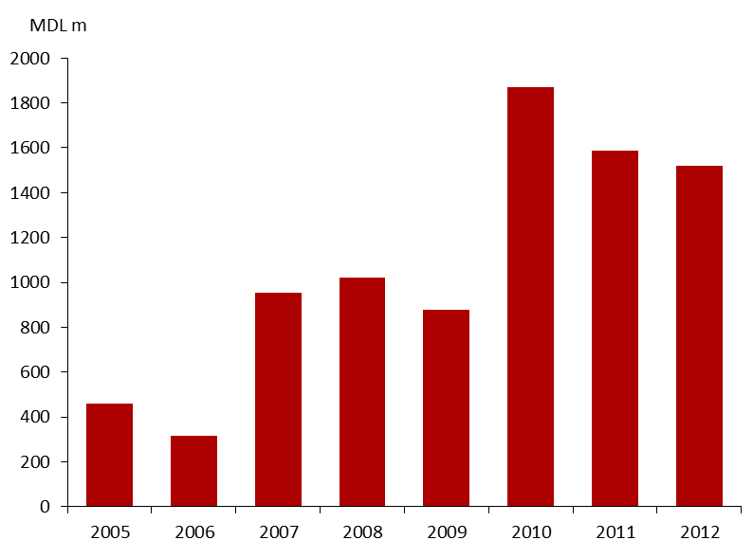
Impact on foreign grants
Public finances in Moldova rely on foreign grants
The economic slowdown and fiscal austerity in the Eurozone caused the donor community to reduce the level of grants
In 2011 and 2012 the amount of disbursed foreign grants decreased, though from a high level
Strained budget situation in the Eurozone has some impact on public finances in Moldova
Foreign grants disbursed to the state budget
Source: Ministry of Finance

Slide 28
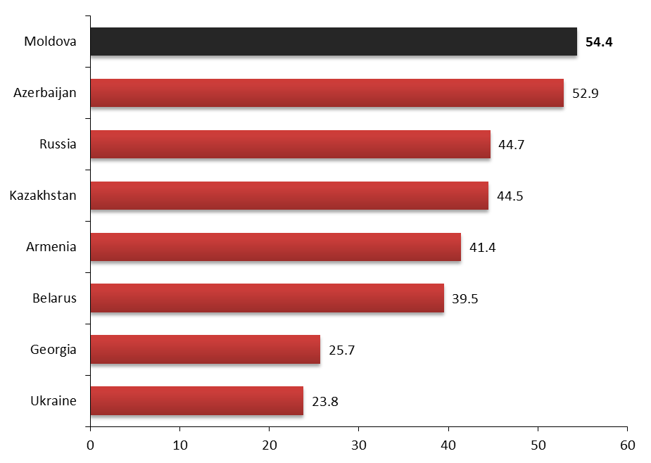
High export exposure to EU
Moldova has among the CIS countries the highest share of exports to the EU in total exports, thus is potentially highly exposed to a demand shock caused by a recession in the Eurozone
However, the relatively low export ratio (exports/GDP ratio is only 29.8%, less than in many other countries) cushions the negative impact on Moldova’s growth to some extent
Exports to EU in % of total, Jan-Aug 2012
Source: Moody’s Investors Service

Slide 29
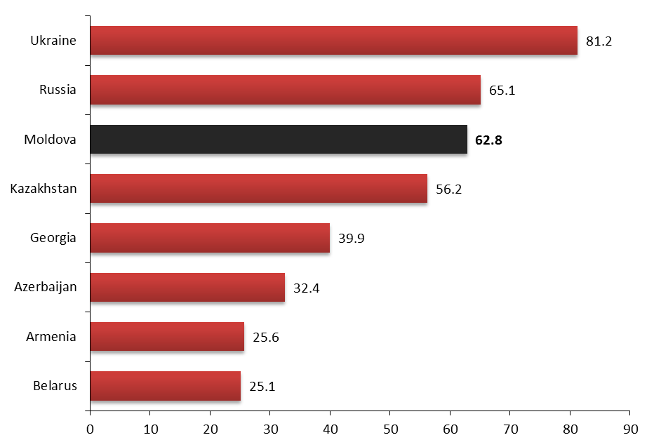
Moldova has also a high exposure to FDI from EU
FDI from EU in % of total, 2011
The importance of FDI flows originating from the EU is also very high for Moldova in a regional context
This high exposure makes Moldova vulnerable to any negative developments in the Eurozone that may impact the willingness and/or ability of firms in the EU to invest abroad
Source: Moody’s Investors Service
Notes:
One more chart with the Moody‘s data (FDI in regional comparison)

